Slide 1

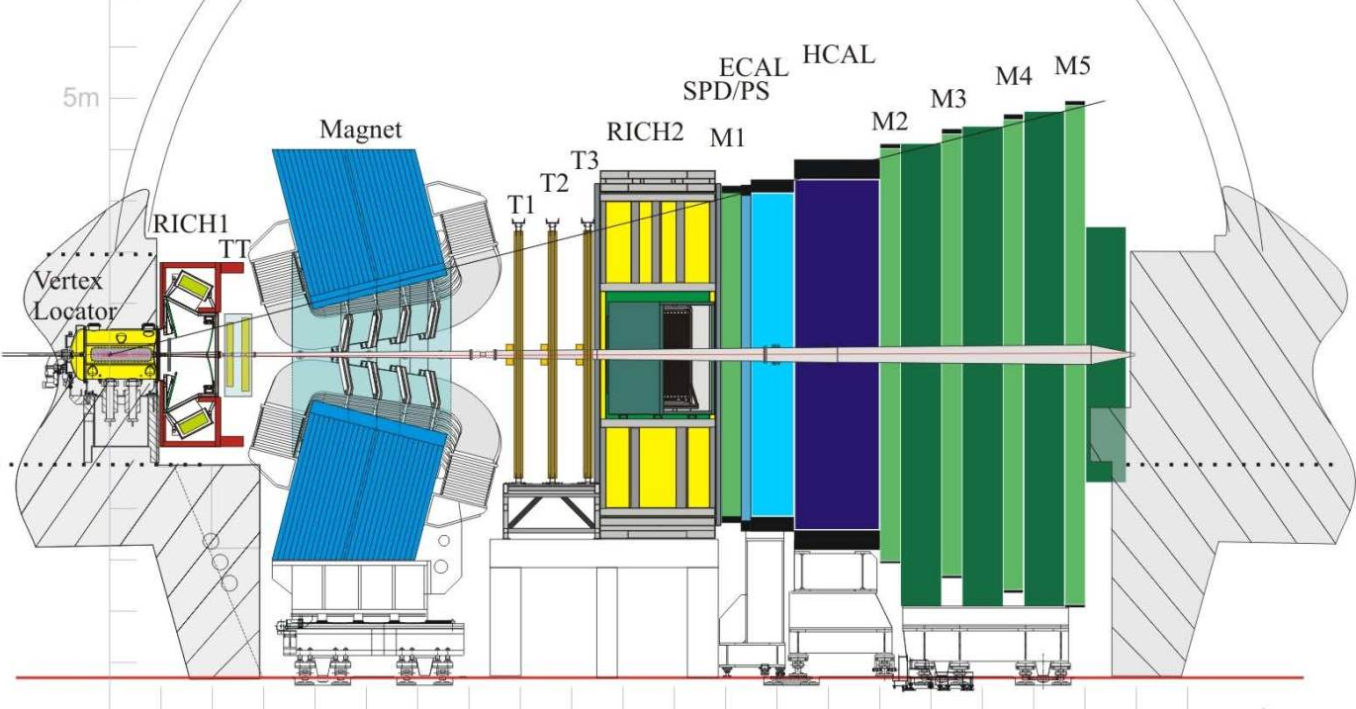
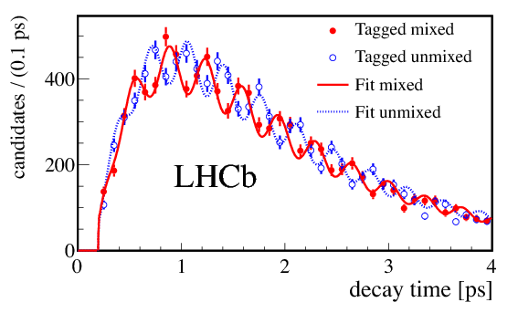
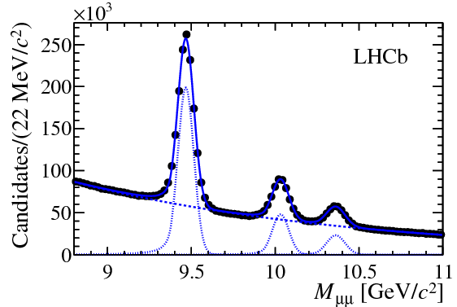
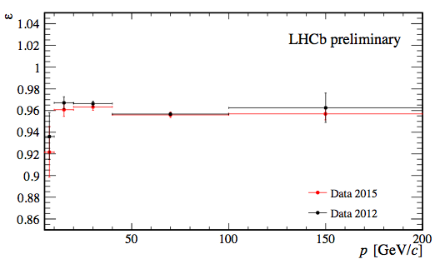
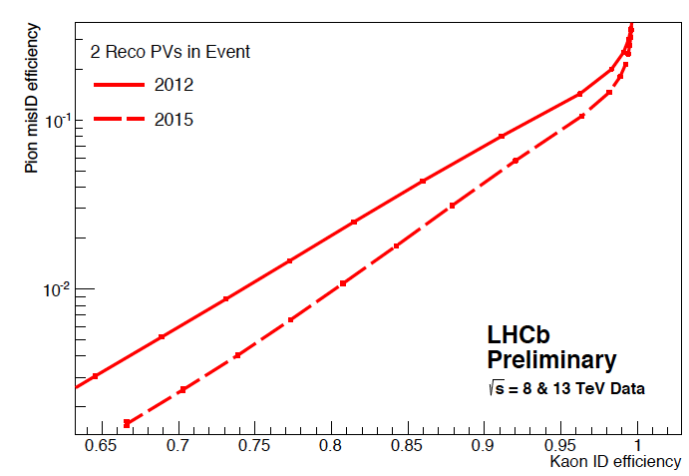
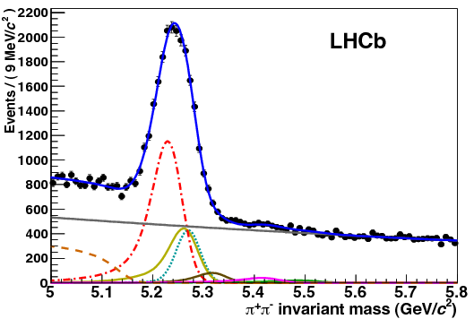
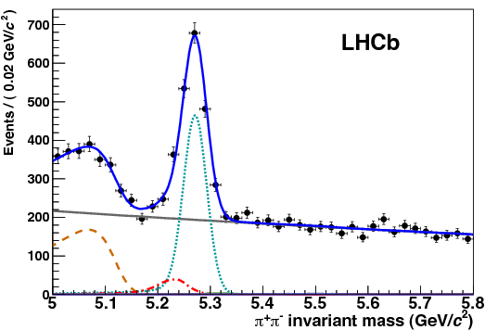
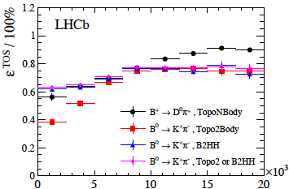
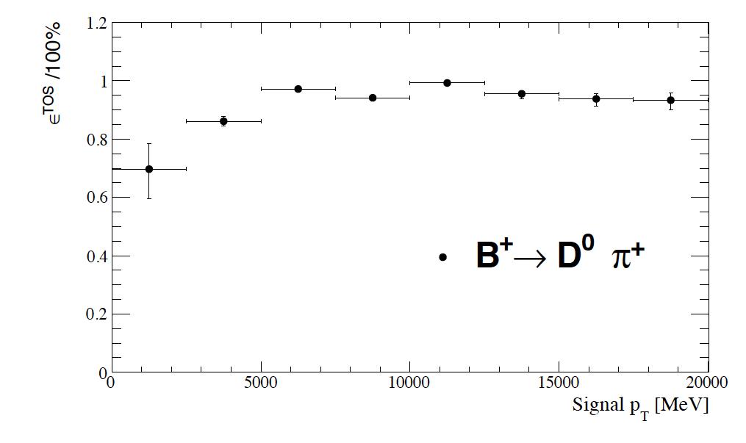
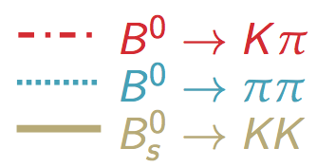
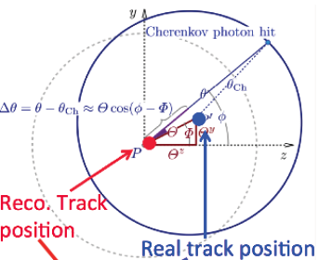
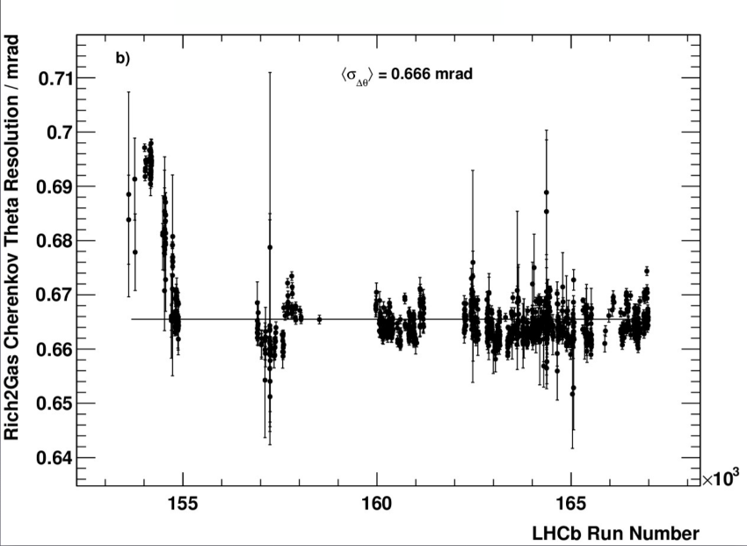
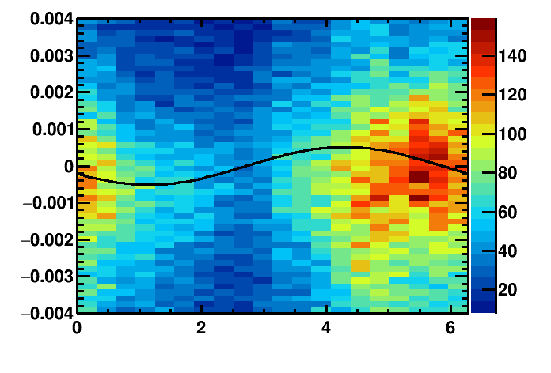
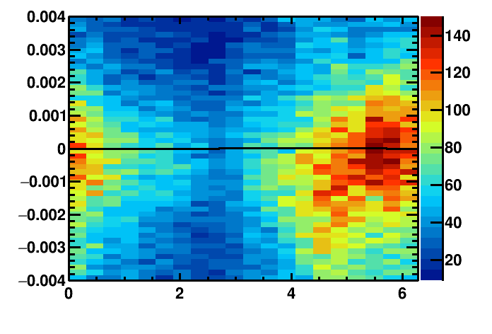
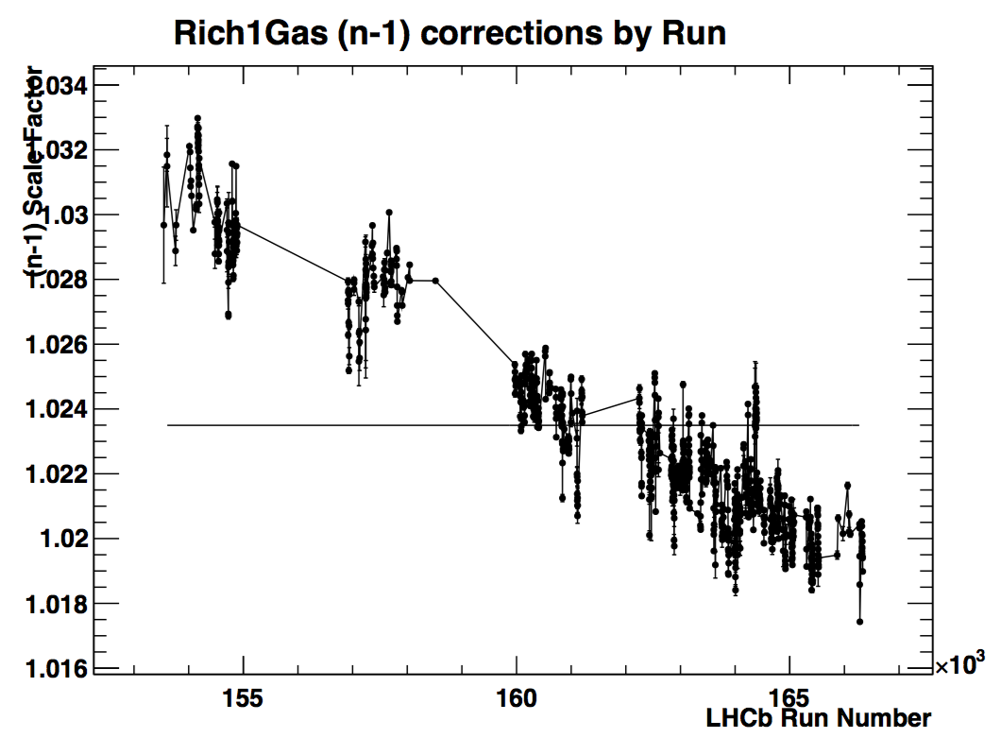
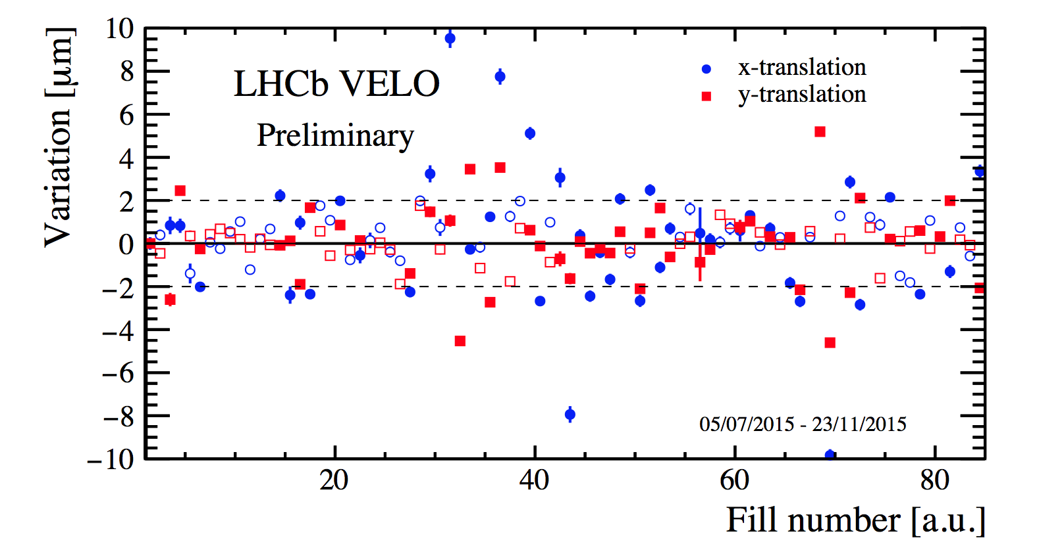
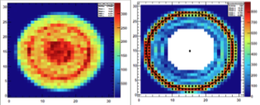
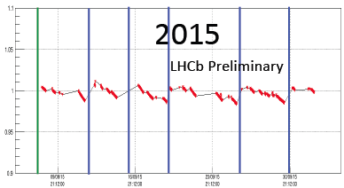
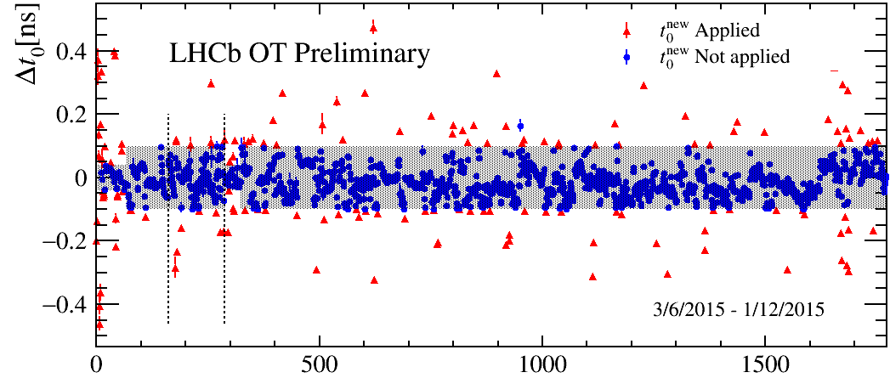
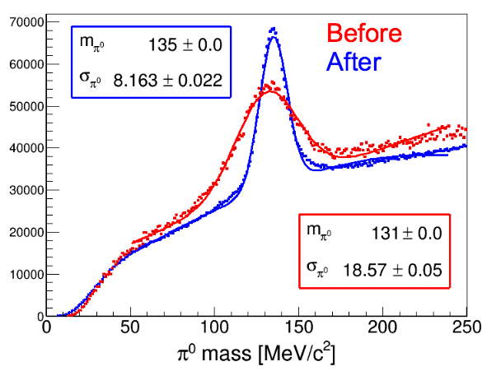
Novel Real-time Calibration and Alignment Procedure for LHCb Run II
Claire Prouve, on behalf of the LHCb collaboration University of Bristol
New challenges in Run II
Real Time Alignment and Calibration
Performance of the LHCb Detector
xxx
Increase in energy: √s = 7(8) TeV ⇒ 13 TeV
15% increase of inelastic collision rate
20% increase of multiplicity per collision
60% increase of σ_{bb} and σ_{cc}
Reduced bunch spacing: 50 ns ⇒ 25 ns
Stable quality of alignment and calibration
Particle identification useable in the high level trigger (HLT)
Overall improved trigger efficiency
No more differences between online and offline
Physics analysis directly on trigger output (Turbo Stream)
Detector P
Particle Identification
Decay-time resolution
B_{s}⁰ →D_{s}⁻ π⁺
Mass resolution
Tracking
Dimuon resonances
LHCb Detector Performance
Int. J. Mod. Phys. A30 (2015) 1530022
New J. Phys. 15 (2013) 053021
Impact on Physics
Improved alignment
LHCb Trigger Schemes
Performance in Run II
First alignment
Tracking efficiency
PID efficiency
σ_{Υ(1S)} = 86 MeV/c²
σ_{Υ(1S)} = 44 MeV/c²
Without PID
With PID
Trigger efficiency:
Run I Run II
LHCb Preliminary
LHCb Preliminary
LHCb Preliminary
Dedicated Framework and Procedure
RICH Mirror Alignment
signal p_{T}[MeV]
ddd
Alignments performed for each fill
Dedicated trigger line for each task
Event reconstruction parallelised on analysers (1700 nodes), computing of alignment constants by iterator (1 node)
Calibrations on monitoring histograms
VELO, Tracker & calibrations: automatic update of the constants if they differ by a given value
RICH alignment & Muon alignment: monitoring mode
ddd
Orientation of the RICH mirrors in x and
Fit the variation of the Cherenkov Δθ as a function of the polar angle ϕ extract the misalignments on the detector plane (Θ_{x}, Θ_{y}) Δθ = Θ_{x} sinϕ+ Θ_{y} cosϕ
Updated O(10) per year
~30 minutes per task
Example of alignment sequence using a Finite State Machine
y
RICH2 Stability
angle
RICH1 Stability
to
Calib.
runs
EM
25 ns
up
Misaligned mirrors
Run number
Cherenkov angle
Cherenkov angle
Aligned mirrors
RICH Calibration
Azimuthal angle ϕ
Azimuthal angle ϕ
Refractive index calibration: Fit to the reconstructed-expected Cherenkov angle yields scale factor for the refractive index
HPD image calibration: Sobel filter applied to each HPD and used to provide calibration
Updated every run
Tracker Alignment: VELO, Tracker, Muon System
RICH1 scale factor
xxxsssss
Position and orientation of the full tracking system (700 elements)
Minimisation of residual of Kalman track fit using additional constraints
Independent alignments:
VELO: updated every O(1) fills
Tracker: updated every O(1) weeks
Muon: updated O(1) per year
~7 minutes per task
Run number
VELO Stability
HPD image
Calorimeter Calibration
ccc
Relative calibration for each cell
Occupancy method and LED monitoring system: adjustment of high voltage settings to compensate for the aging of the detector
Updated per fill
Calibrate to the neutral π mass
Fit the π⁰ mass distribution for each cell for π⁰ γγ
Run on the HLT-farm during TS
LED average
Outer Tracker Calibration
xxx
Global time alignment for all modules
Fit the residual of the drift time to extract the global time delay t₀ caused by readout electronics t_{meas} = t₀ + t_{flight} + t_{drift} + t_{prop}
Updated every O(10) runs
OT Stability
π⁰ calibration
Run number
m(γγ)/[MeV]
LHCC - 02 March 2016 - Poster Session

